Slide 1
ExploreAI Regression Project
Kimaya Setty Lungisani Khanyile
Revahn Macauley
Saabier Matthews
Dylan Hogan

Slide 2
Introduction
We have been engaged by agricultural stakeholders to analyze and forecast the effects of CO₂ emissions from the agri-food sector on climate change. This project involves policymakers, agricultural businesses, and environmental organizations working together to assess agricultural activities' environmental impact and develop sustainable strategies. Using data from the Food and Agriculture Organization (FAO) and the Intergovernmental Panel on Climate Change (IPCC), the team will examine various emission sources, perform regression analysis on temperature changes, and generate actionable insights. The project’s findings will offer valuable recommendations to promote sustainability in the agri-food sector.

Slide 3
Project Scope
Data Cleaning
EDA
Feature Selection
Model Selection
Model Evaluation
Conclusion

Slide 4
Data Cleaning
After evaluating the data. Based on the the nulls in the emissions dataset and their impact to the data, it was decided to drop the following fields:
Savanna fires
Fires in organic soils
Fires in humid tropical forests
Drained organic soils (CO2)
Crop Residuals
IPPU
Manure applied to Soils
Manure Management
On-farm energy use
While the remaining observations with nulls were removed. This was done to prevent potential bias that may occur by filling the data with a fixed value or interpolation.

Slide 5
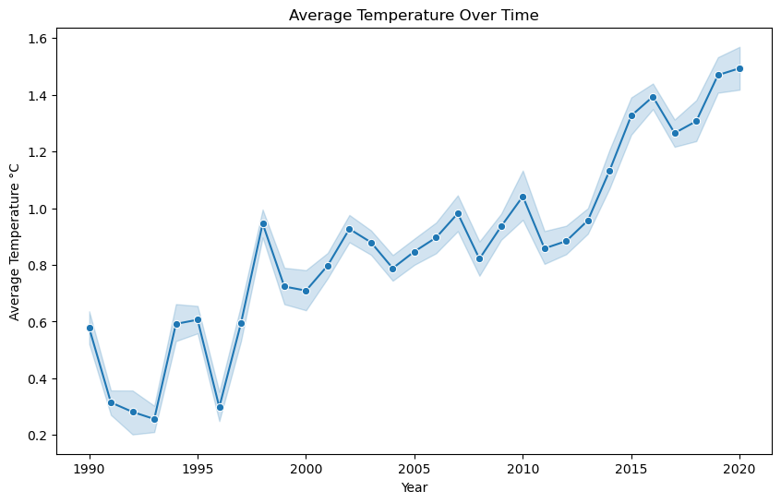
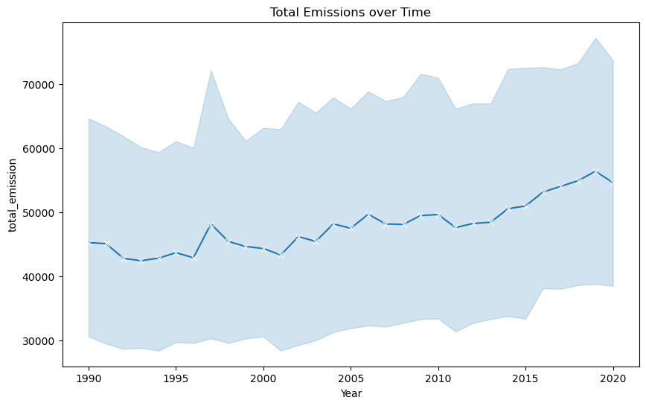
Exploratory Data Analysis

Slide 6
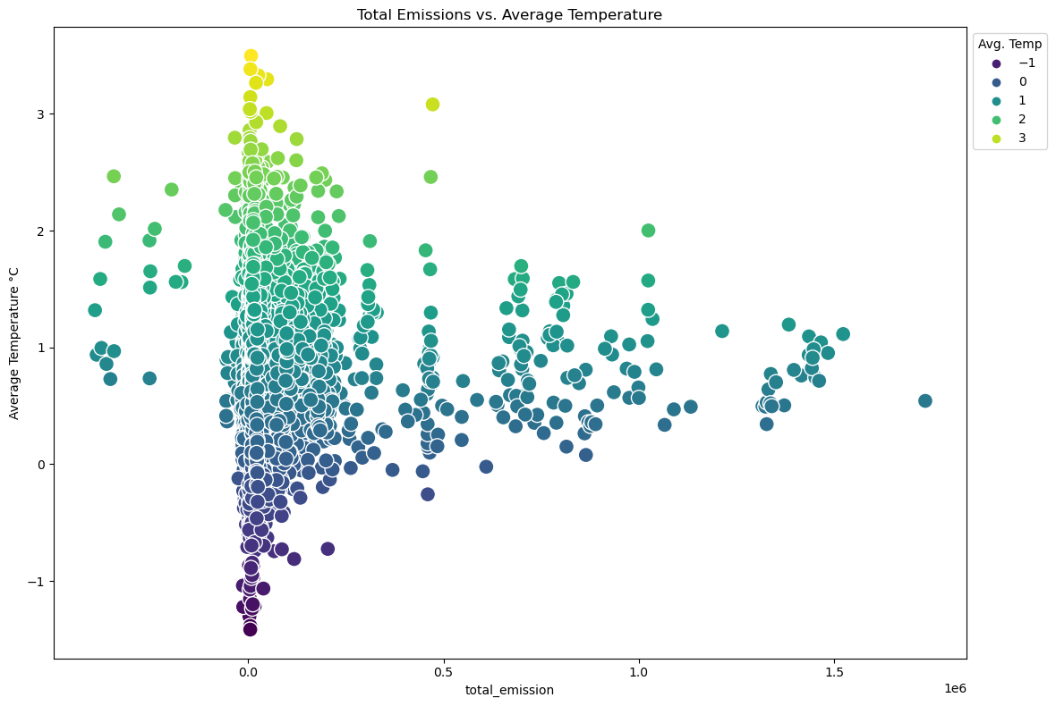
Exploratory Data Analysis
The highest emissions appear to be when temperatures are a bit lower

Slide 7
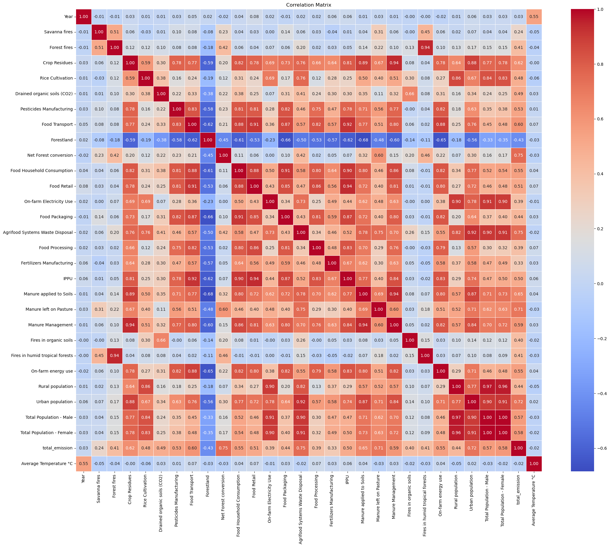
Exploratory Data Analysis

Slide 8
Feature Selection
Based on the null features the following features are excluded.
Crop Residuals
IPPU
Manure applied to Soils
Manure Management
On-farm energy use
And based the correlation Matrix some features need to be excluded to remove dependant variables.
Rural Population (Correlates with Urban Population, Total Population - Male, Total Population - Female and more… )
Total Population - Female (Correlates with Total Population - Male)

Slide 9
Model Selection
The following Models were evaluated:
Linear Regression
Decision Tree
Random Forest
Lasso Regression
Ridge Regression
Support Vector Regression
Gradient Boosting

Slide 10
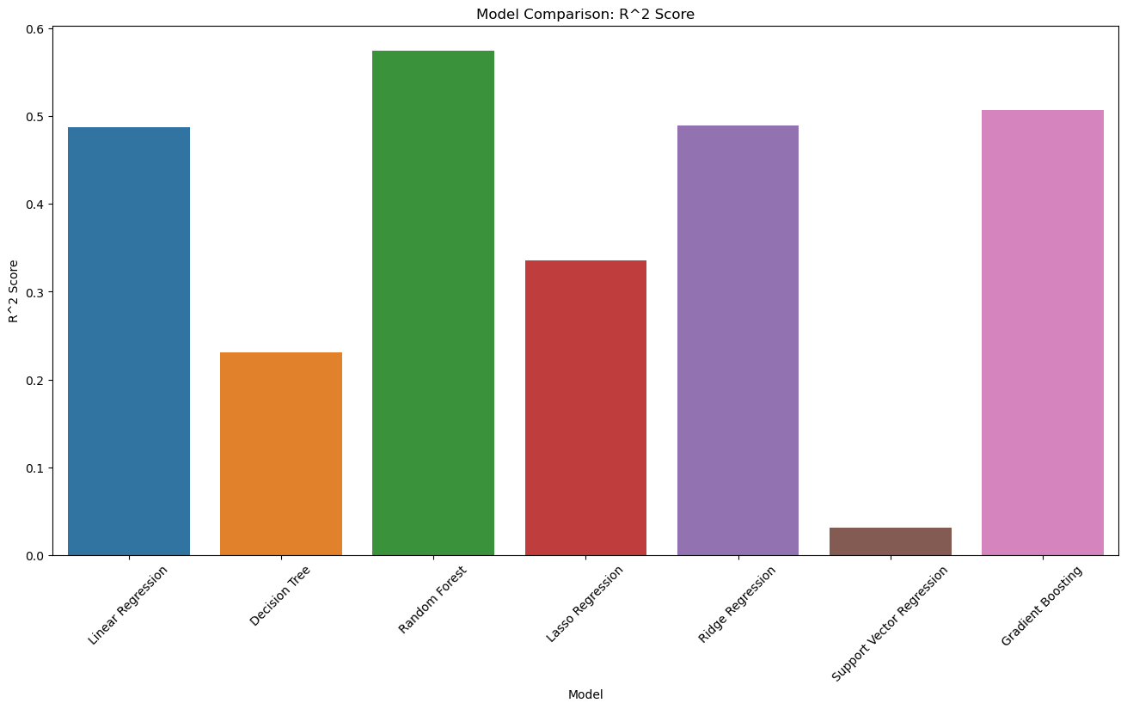
Model Evaluation
Model | Mean Squared Error | R^2 Score
Linear Regression | 0.158581 | 0.487982
Decision Tree | 0.238059 | 0.231368
Random Forest | 0.131762 | 0.574575
Lasso Regression | 0.205802 | 0.335518
Ridge Regression | 0.157974 | 0.489943
Support Vector Regression | 0.300017 | 0.031323
Gradient Boosting | 0.152607 | 0.507272

Slide 11
Conclusion
Based on the evaluation above, We decided that the Random Forest would be the best model as has the best Correlation value as well as the lowest Mean Squared Value FUTURE WORKS
We recommend that we investigate an Ensemble of the the recommended Models, this may provide better results than all the models combined.

